Slide 1
Calculating 20 billion point-to-point travel times
or
Abusing three technologies to make fun maps

Slide 2
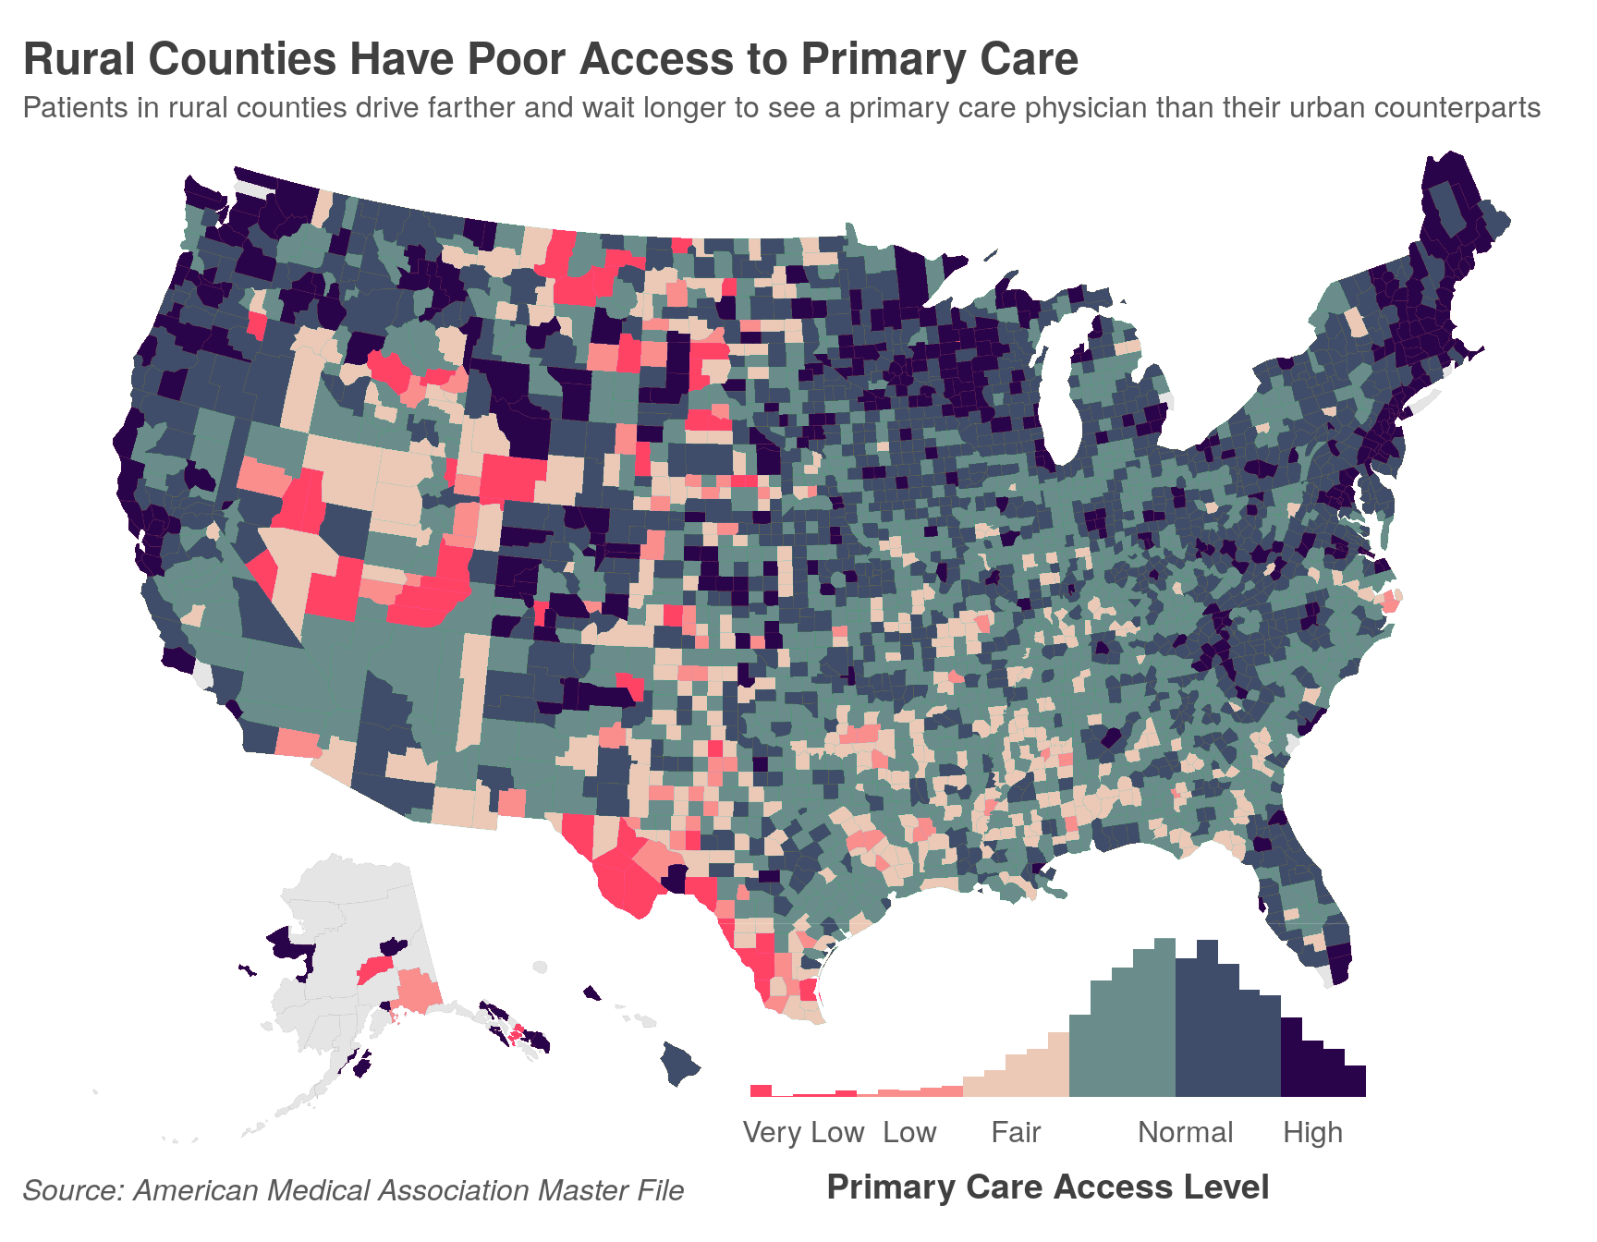
Why travel times?
(Why on earth would you do this at all?)
Used by researchers, academics, urban planners
There’s a gap in the FOSS ecosystem. Most researchers buy from Esri (~5K per year)
It’s a fun technical challenge

Slide 3
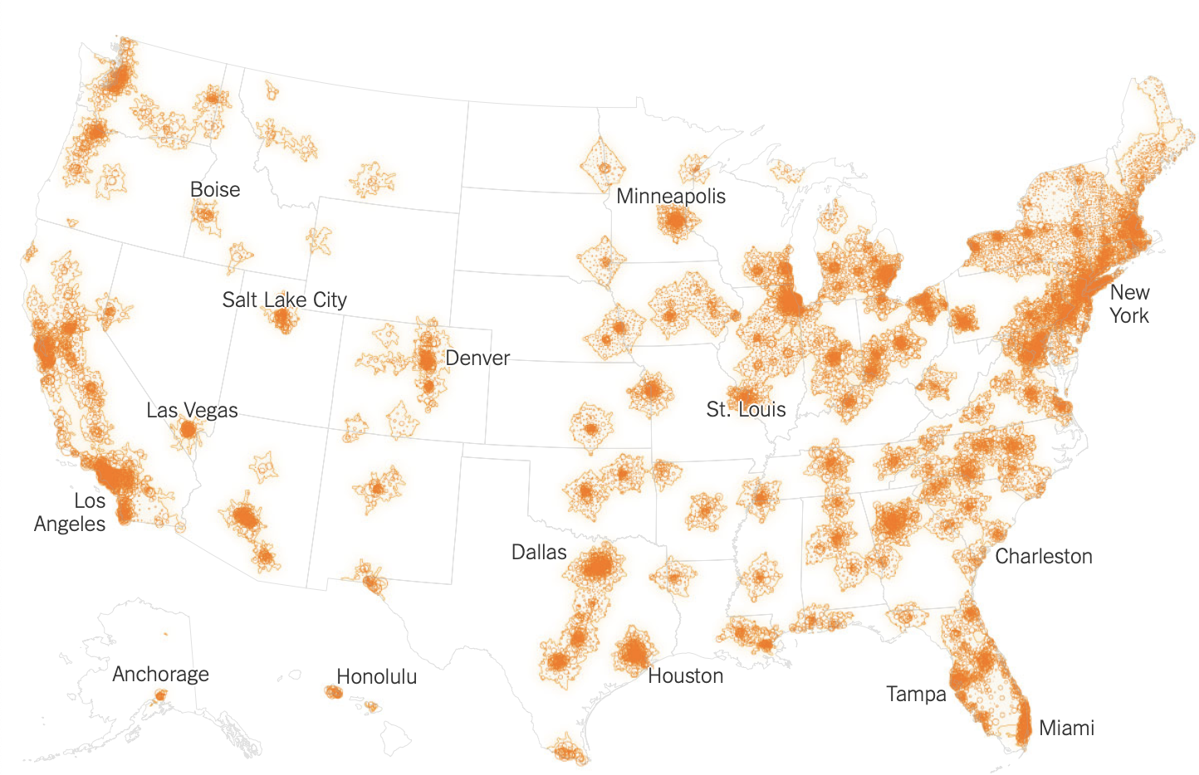
Why travel times?
(Why on earth would you do this at all?)
Used by researchers, academics, urban planners
There’s a gap in the FOSS ecosystem. Most researchers buy from Esri (~5K per year)
It’s a fun technical challenge
Within 1-hour drive of nearest abortion facility
52.9 million women of reproductive age
Source: NYTimes

Slide 4

What are travel times?
Point-to-point time (in seconds) ala Google Maps
Three different travel modes:
Driving
Cycling
Walking
Transit
Source: Google Maps

Slide 5
What are travel times?
We want many times, so the output is a matrix
IDs correspond to a point in space (lat/lon)
Each origin maps to many destinations
Origin | Destination | Duration (seconds) | Distance (kilometers)
17031031502 | 17031031502 | 0 | 0
17031031502 | 17031830700 | 103 | 0.418
17031031502 | 17031032100 | 165 | 0.851
17031031502 | 17031031501 | 190 | 0.568
17031031502 | 17031031400 | 203 | 1.184
17031031502 | 17031031700 | 204 | 1.09
17031031502 | 17031832100 | 270 | 1.574
17031031502 | 17031030603 | 273 | 3.333
17031031502 | 17031060800 | 304 | 2.138
17031031502 | 17031030604 | 305 | 3.299
17031031502 | 17031031200 | 325 | 1.343
17031031502 | 17031031900 | 332 | 1.89

Slide 6
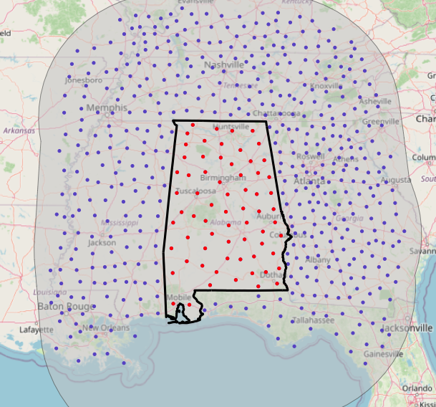
What are travel times?
Origin | Destination | Duration (seconds) | Distance (kilometers)
17031031502 | 17031031502 | 0 | 0
17031031502 | 17031830700 | 103 | 0.418
17031031502 | 17031032100 | 165 | 0.851
17031031502 | 17031031501 | 190 | 0.568
17031031502 | 17031031400 | 203 | 1.184
17031031502 | 17031031700 | 204 | 1.09
17031031502 | 17031832100 | 270 | 1.574
17031031502 | 17031030603 | 273 | 3.333
17031031502 | 17031060800 | 304 | 2.138
17031031502 | 17031030604 | 305 | 3.299
17031031502 | 17031031200 | 325 | 1.343
17031031502 | 17031031900 | 332 | 1.89

Slide 7
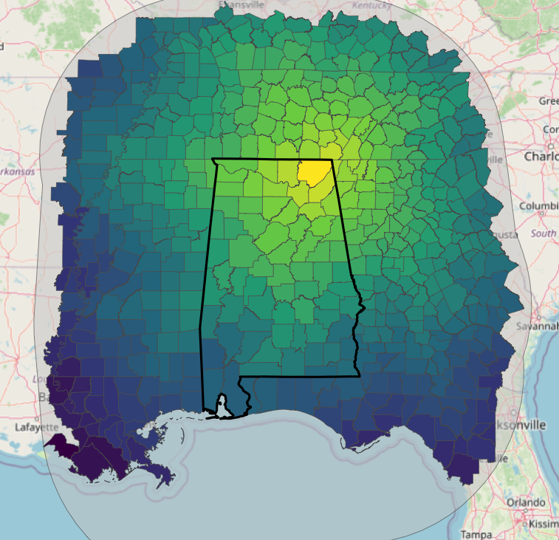
What are travel times?
Origin | Destination | Duration (seconds) | Distance (kilometers)
17031031502 | 17031031502 | 0 | 0
17031031502 | 17031830700 | 103 | 0.418
17031031502 | 17031032100 | 165 | 0.851
17031031502 | 17031031501 | 190 | 0.568
17031031502 | 17031031400 | 203 | 1.184
17031031502 | 17031031700 | 204 | 1.09
17031031502 | 17031832100 | 270 | 1.574
17031031502 | 17031030603 | 273 | 3.333
17031031502 | 17031060800 | 304 | 2.138
17031031502 | 17031030604 | 305 | 3.299
17031031502 | 17031031200 | 325 | 1.343
17031031502 | 17031031900 | 332 | 1.89

Slide 8
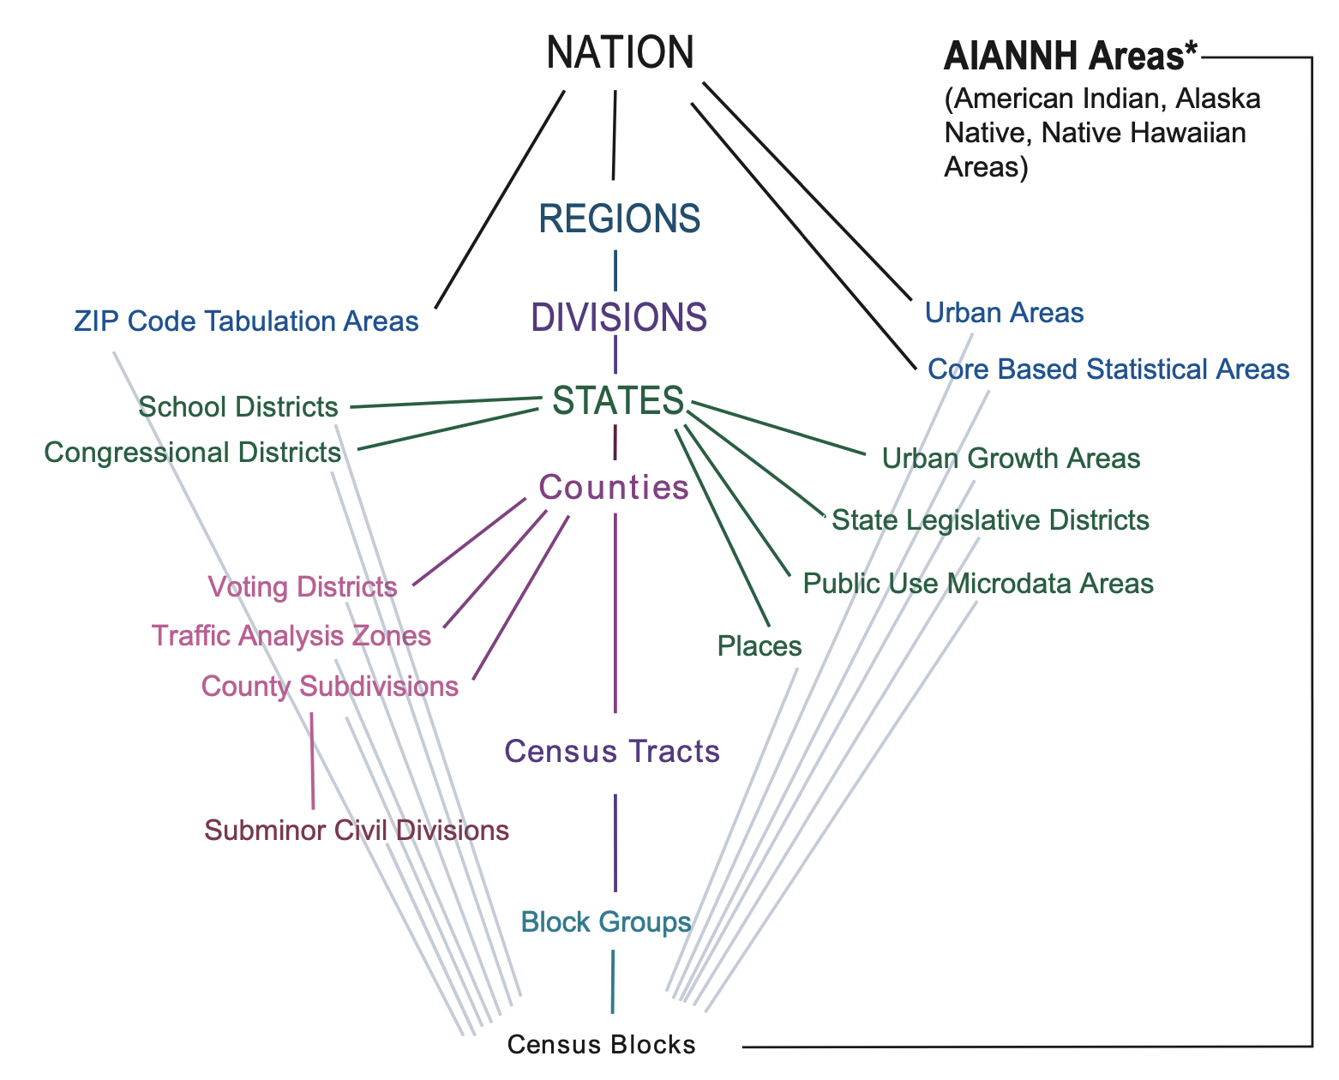
Travel times to what?
Census areas!
We want travel times between all Census geographies in the United States
Origin = center/mean of the geography

Slide 9
How many travel times?
For Census tracts:
~ 73K origins
~10K dests. each
5 years of data
✕ 3 travel modes
≈ 11 billion

Slide 10
Project goal:
Calculate ~20 billion travel times between all U.S. Census geographies, then make them available for free
(and keep my hosting costs low)

Slide 11
Three challenges:
Collect and manage the input data
Actually calculate the times
Serve the output data for free

Slide 12
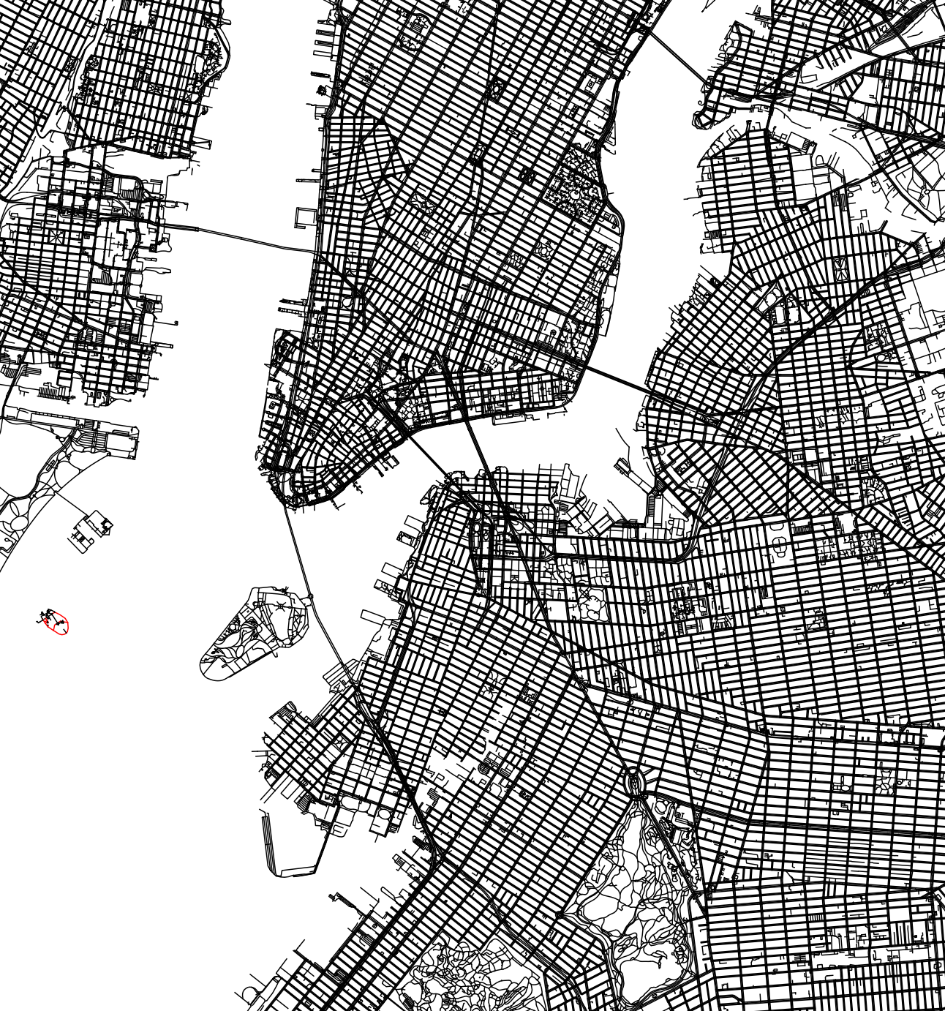
C1. Collecting and managing input data
What we need:
Street network data

Slide 13
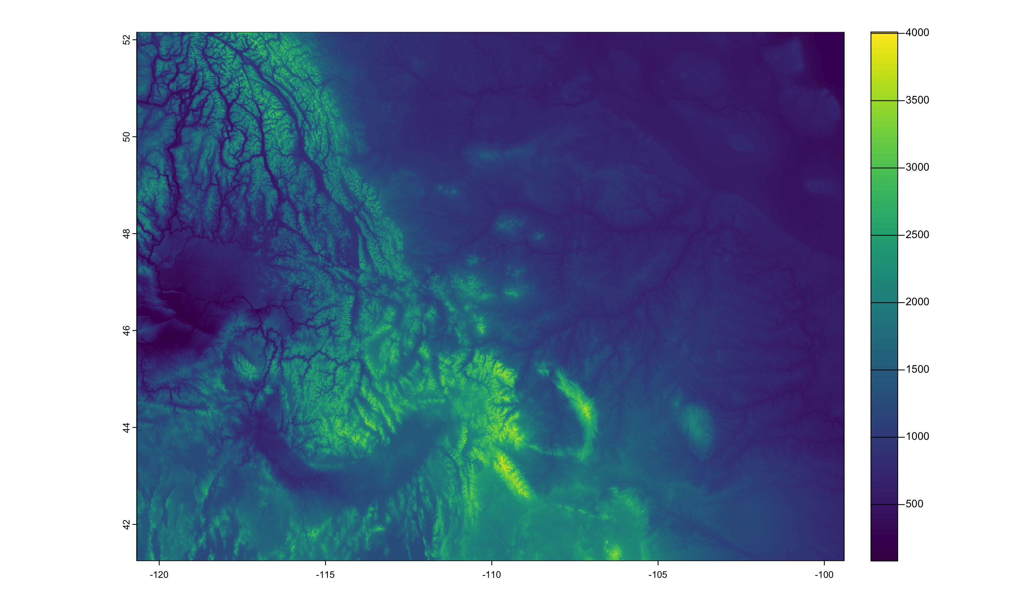
C1. Collecting and managing input data
What we need:
Street network data
Elevation data

Slide 14
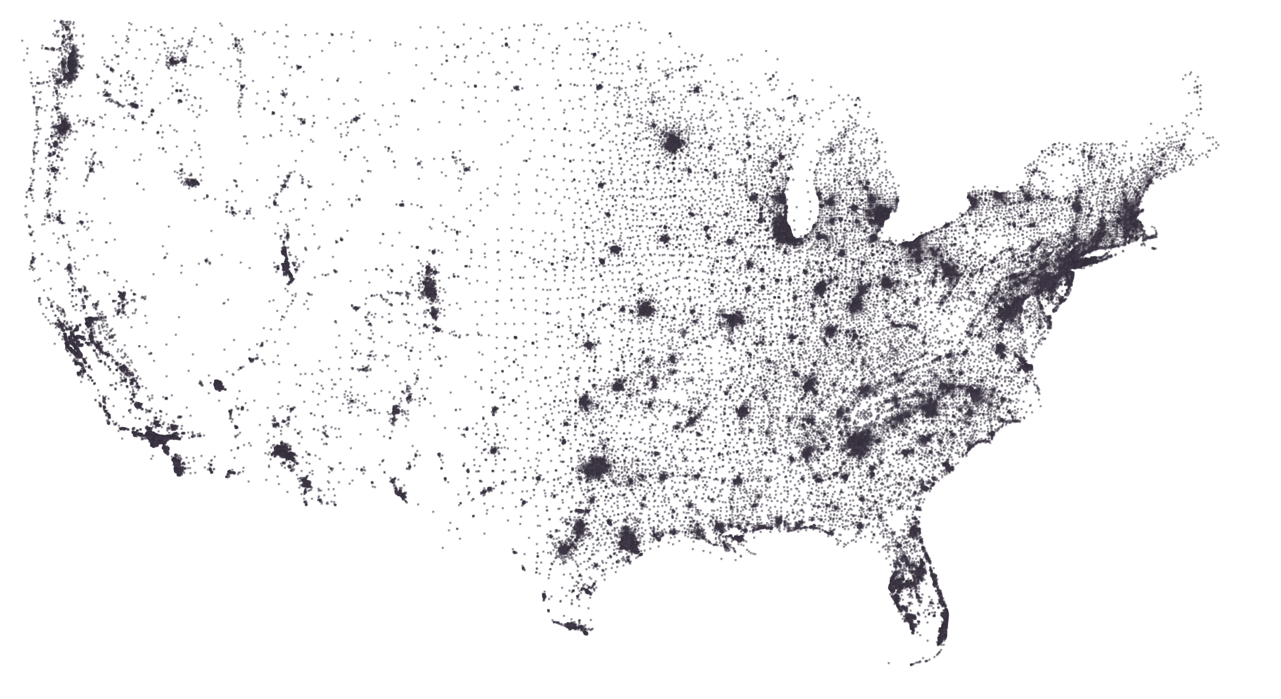
C1. Collecting and managing input data
What we need:
Street network data
Elevation data
Origins/destinations

Slide 15
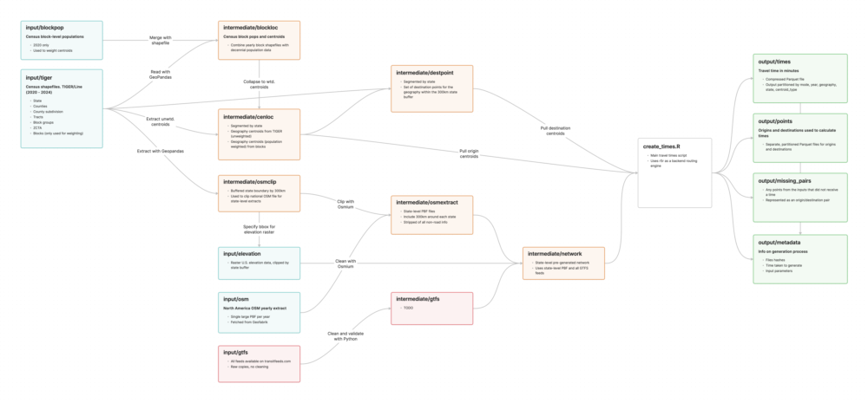

C1. Collecting and managing input data

Slide 16
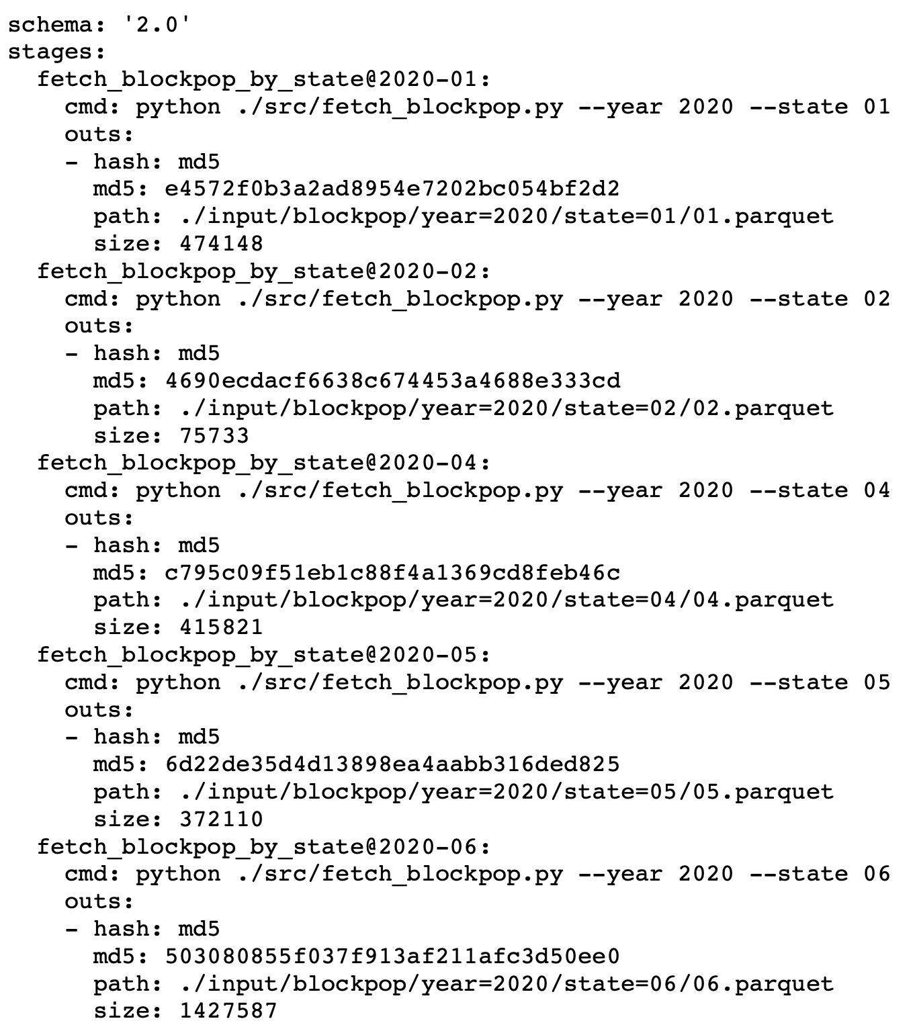
C1. Collecting and managing input data
All data is cached on S3
Intermediate steps also cached. State stored in git
Total input / intermediate data ≈ 750 GB

Slide 17
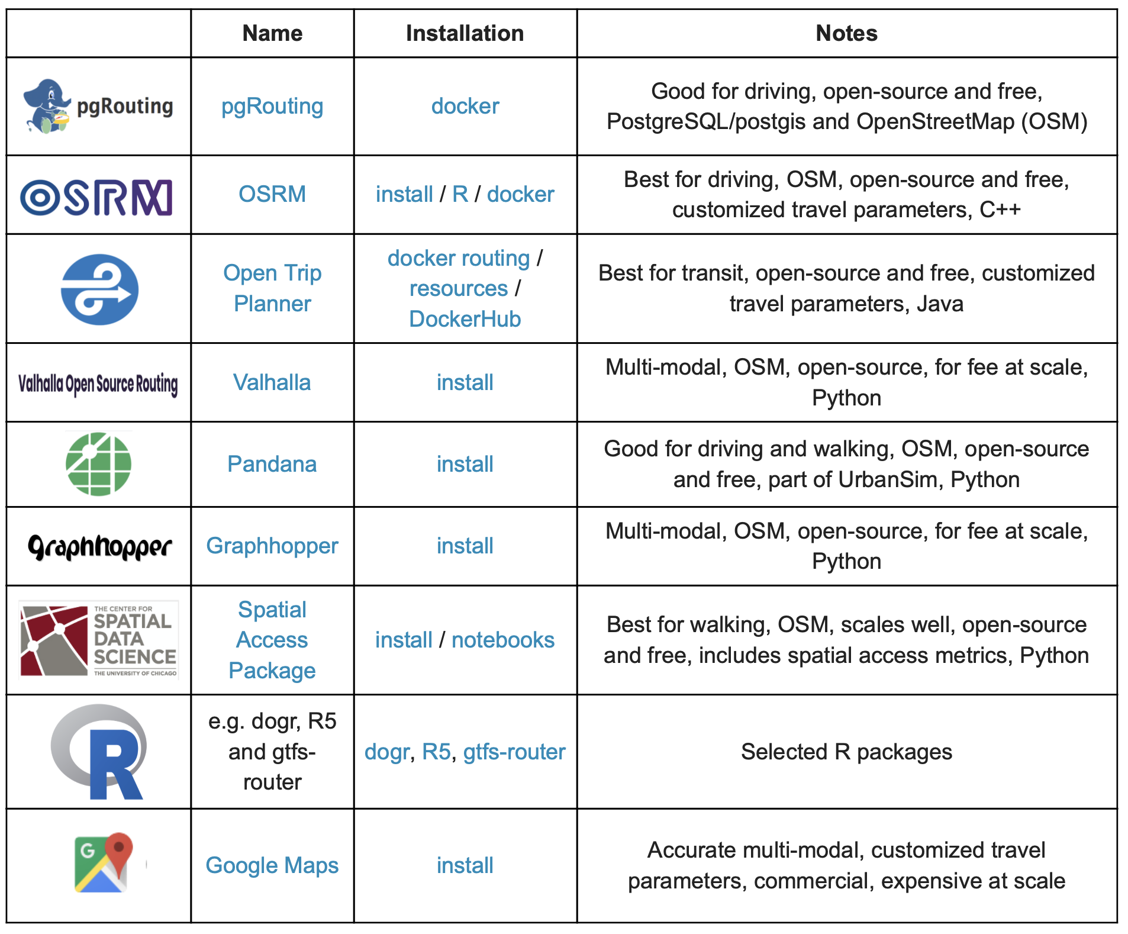
C2. Calculating the actual travel times
All inputs are fed to a routing engine, which does the time calculation
I initially chose R5; it took ~5 hours to run for a single state. Time to scale up…
Source: PySAL

Slide 18
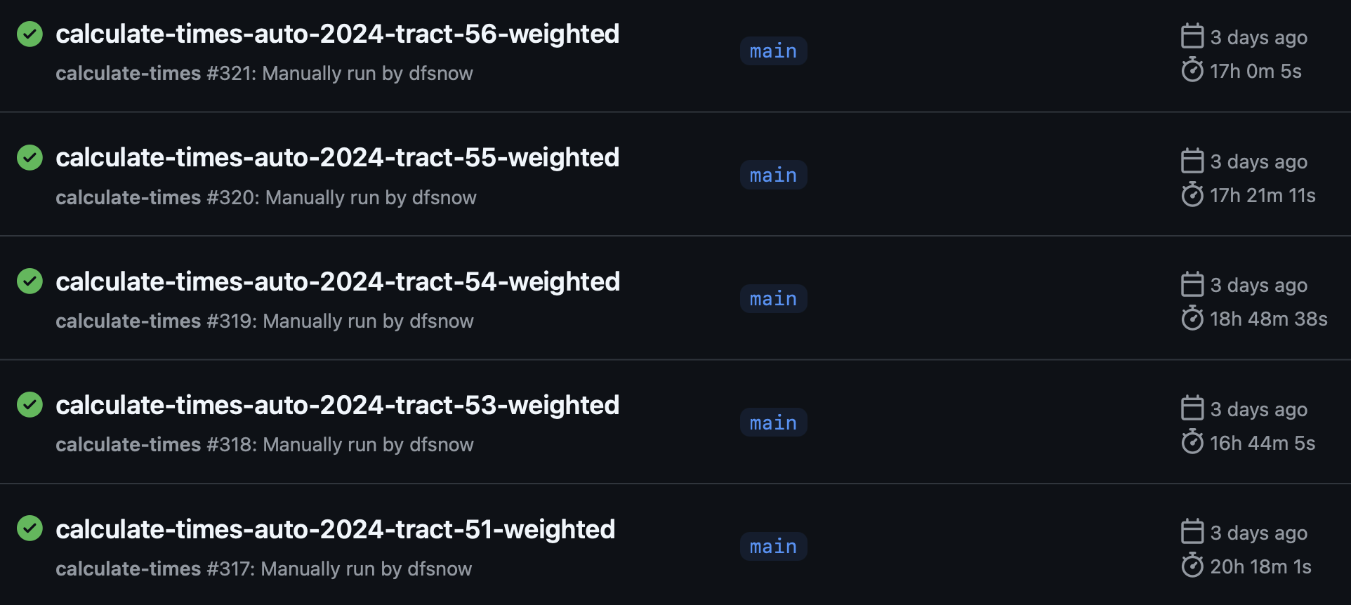
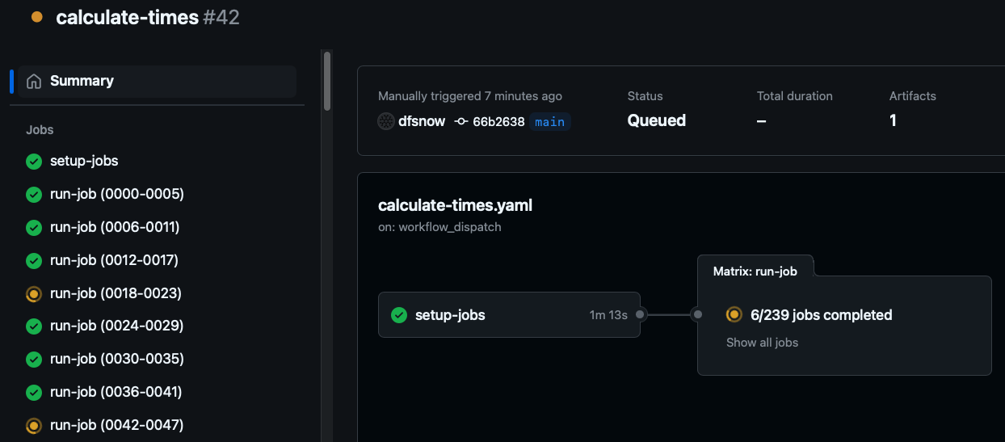
Distributed computing via GitHub Actions
Each state is a workflow, and each workflow can run 256 jobs
20 concurrent jobs maximum

Slide 19
Distributed computing via GitHub Actions
Since starting, I’ve used ~400 days of compute
But it still wasn’t enough…

Slide 20
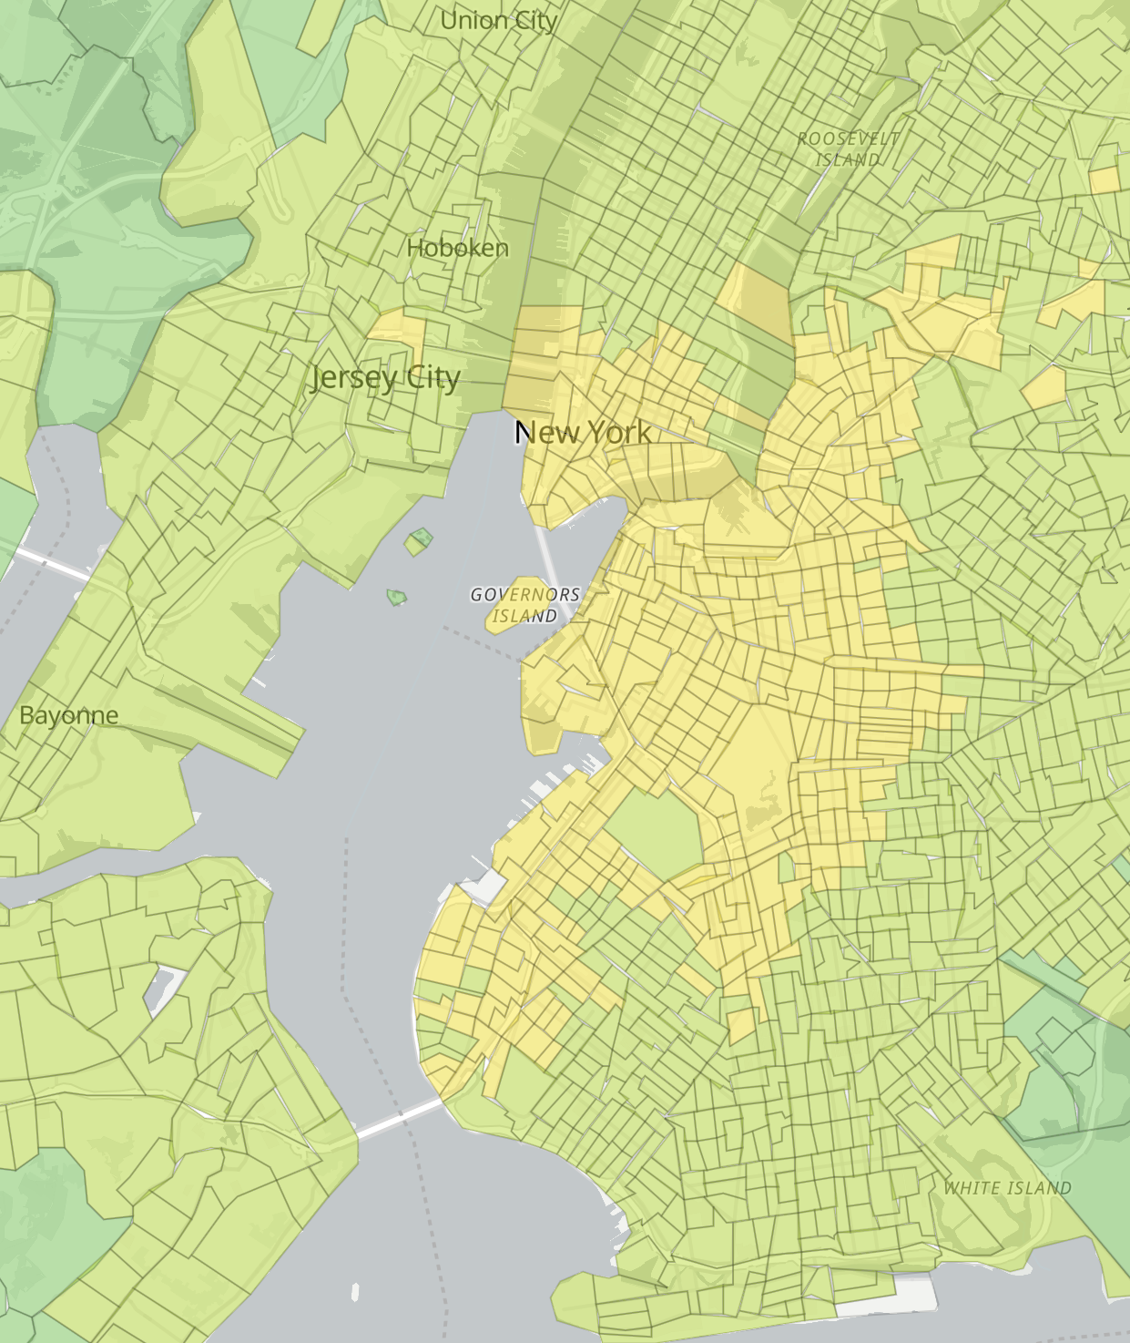
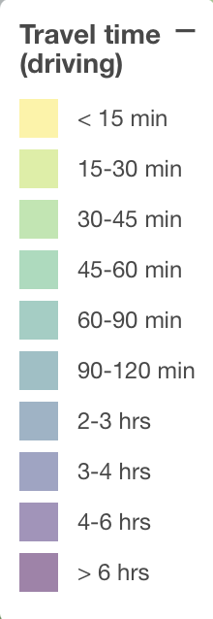
C2. Calculating the actual travel times
Eventually switched to Valhalla routing engine
Full U.S. run for just tracts takes ~1 day
Each job outputs a single Parquet file to S3

Slide 21


C3. Serving the output data (for free)
All told we’ll have ~400GB of compressed Parquet
Users could download the files directly, but egress fees would eat me alive
Unless…
(AWS S3)
Too lazy to make a Drake meme

Slide 22

C3. Serving the output data (for free)
SELECT *
FROM public.times
WHERE version = '0.0.1’
AND mode = 'auto'
AND year = '2024'
AND geography = 'tract'
AND centroid_type = 'weighted'
AND state = '17'
AND origin_id = '17031031502'
Users can query the Parquet directly over HTTPS using DuckDB
DuckDB is smart and will skip files based on URL, then do range requests
https://example.com/version=0.0.1/ year=2024/geography=tract/centroid_ type=weighted/state=17/part-0.parquet

Slide 23
C3. Serving the output data (for free)
Researchers download a database of views with pointers to all 6K files
Can use a (forthcoming) R or Python wrapper to fetch the times they need

Slide 24

Challenge check-in:
✅
Collect and manage the input data
Actually calculate the times
Serve the output data for free
✅
✅

Slide 25
But what does all this get us?
opentimes.org

Slide 26
Future work
Finish calculating all times
Create Python and R wrapper packages
Add more travel modes (i.e. public transit)
Build out the website more
Improve accuracy (add traffic, etc.)

Slide 27
END

